Slide 1
Measuring integrated information in the fly brain
Angus Leung 2018-09-12

Slide 2
Overview
Integrated information theory (IIT)
Principles
Implementation
Applying IIT to flies

Slide 3
Integrated information theory
What is the physical substrate of consciousness?
Idea: introspect own conscious experience (the only one you have access to)
Come up with some key properties of conscious experience
Key properties - Have to be true for all types of conscious experience
Any physical substrate which supports/implements these key descriptors is conscious!
Notes:
Need background slide - why IIT?

Slide 4
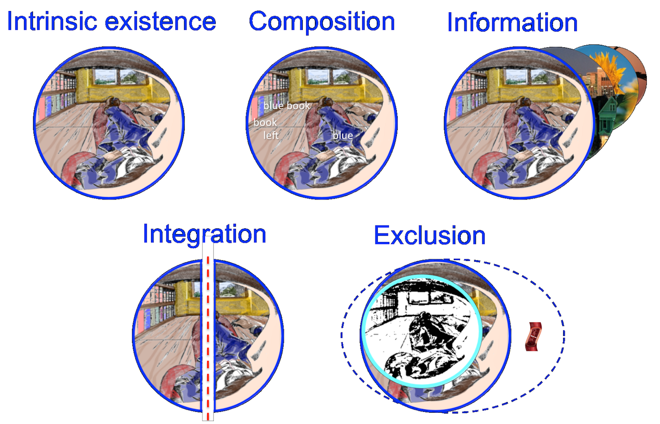
Axioms of Integrated Information Theory (IIT)
Tononi, 2015
Notes:
http://www.scholarpedia.org/article/Integrated_information_theory

Slide 5
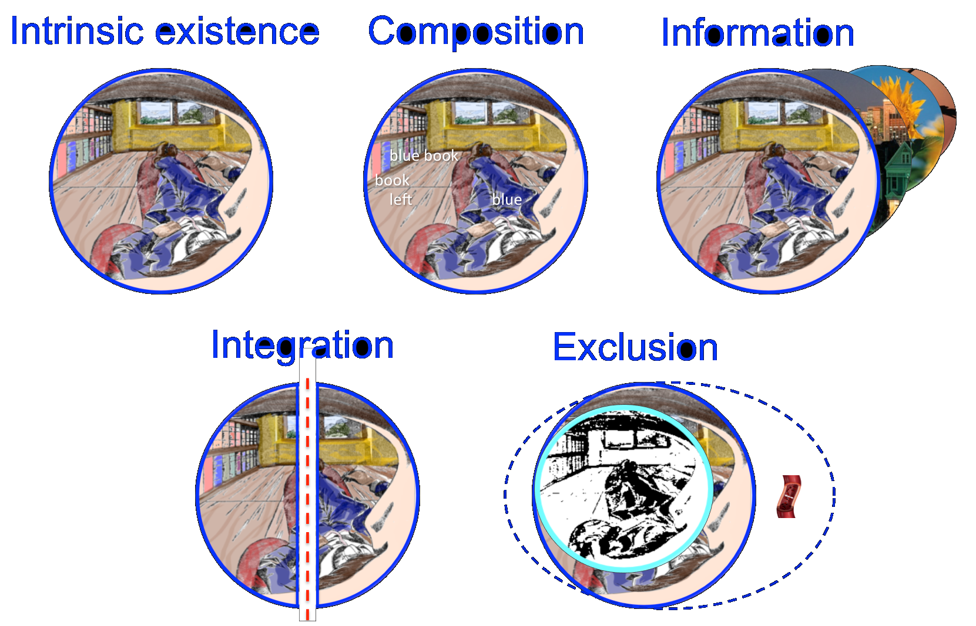
Intrinsic existence
effect
Object
Observer
effect
Notes:
Physical existence

Slide 6
Intrinsic existence
effect
Observer
Observer
effect
Notes:
Intrinsic existence (consciousness)

Slide 7
Composition

Slide 8
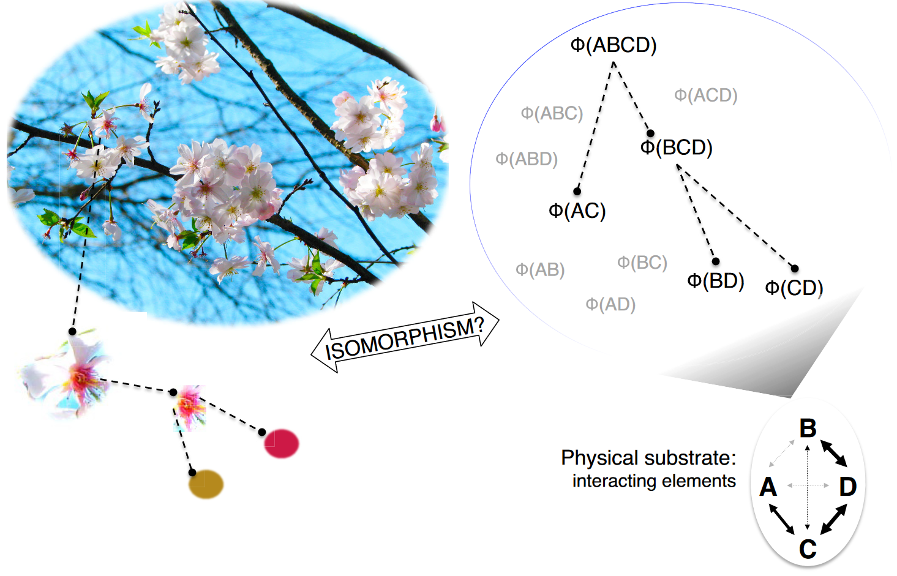
Composition
Haun et al., 2017 eNeuro
Notes:
Mechanism has to exist intrinsically (for the system)
Mechanism information - red flower, as opposed blue flower
System information - flowers on a tree, as opposed to in a vase, or as opposed to the sky
Source: Haun et al., 2017, http://www.eneuro.org/content/early/2017/09/19/ENEURO.0085-17.2017

Slide 9
Information

Slide 10
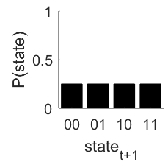
Information
t
t+1
A
?
?
B
No information

Slide 11
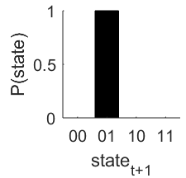
Information
t
t+1
A
copy
copy
B

Slide 12
Information
Information = change/reduction in uncertainty
Information
Notes:
So specifying some single thing from a large set of possibilities gives a lot of information

Slide 13
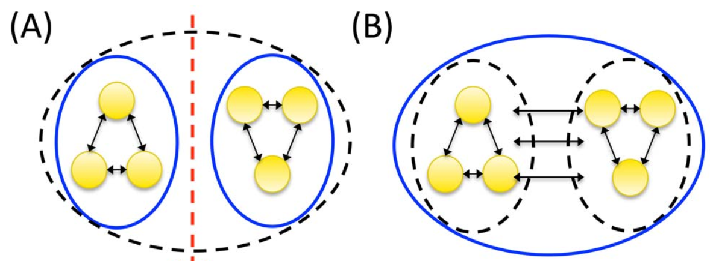
Integration
Notes:
Graph image source: Oizumi 2014

Slide 14
Integrated information
A
A
copy
copy
?
?
???
B
B

Slide 15
Integrated Information
φ = 0
Not integrated
A
A
B
B
Integrated
φ > 0

Slide 16
Composition
φ = ?
Each “mechanism” O specifies some concept
Concept contributes to conscious experience if φ > 0
Concepts compose conscious experience if integrated
φ = ?
A
A
A
A
B
B
B
φ = ?
A
B
B
Notes:
For example, if A could hold the concept of a mouth, B could hold the concept of eyes, and AB together is the concept of a face

Slide 17
Composition
φ = ?
Each “mechanism” O specifies some concept
Concept contributes to conscious experience if φ > 0
Concepts compose conscious experience if integrated
φ = ?
A
A
A
A
B
B
B
φ = ?
A
B
B
Notes:
Each mechanism has its effects on the system (constrained repertoire)

Slide 18
Integrated information Φ
A
A
AB
AB
B
B
Integrated information Φ
A
B
A
B
Full system
Split system

Slide 19
Exclusion
Notes:
In principle you have the capability of experiencing a subset of your experience, but you don’t
You can also experience more, like your heartbeat which is always within you, but you don’t

Slide 20
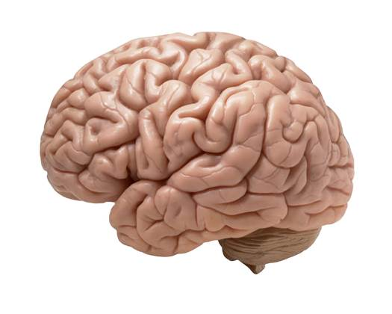
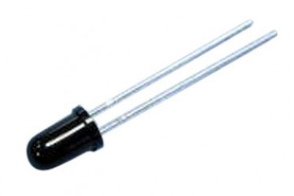
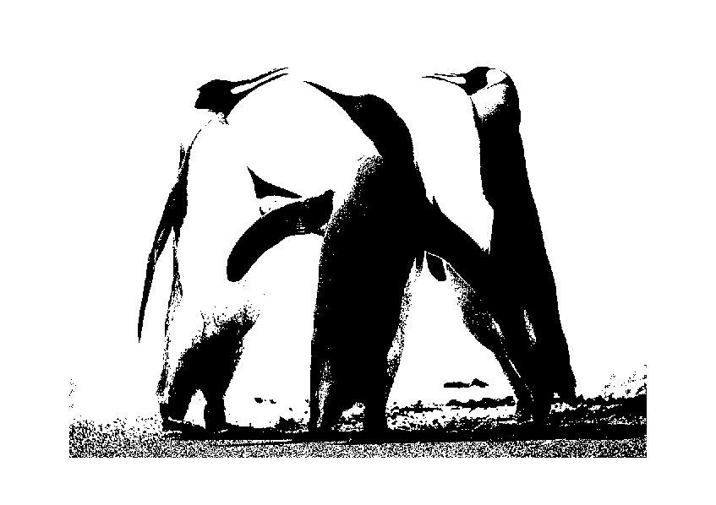
Integrated information
Photodiode
on/off = 1 bit
Substrate: single diode
Brain
10¹¹ neurons firing/not-firing = 10¹¹ bits
Substrate: highly interconnected neurons
Digital black/white image
Number of pixels x black/white = n bits
Substrate: individual pixels
Notes:
Compare axioms, esp. integration and information for each example
Image sources:
https://www.popsci.com.au/science/medicine/tiny-sophisticated-human-brain-grown-in-a-dish-,408232
https://uge-one.com/photo-diode-bp333.html
https://www.quora.com/What-is-the-difference-between-a-binary-image-and-a-gray-scale-image

Slide 21

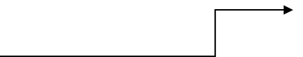
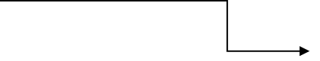

Integrated information
Integrated O
O = exists only when considering the whole
O = reduction due to splitting
Information I
I = change/reduction in uncertainty
Uncertainty = set of possibilities and their probabilities
Whole system
Another neuron
1 neuron, 2 possible states
Notes:
Need to link to here - we want to create a measure, existence, composition, exclusion are more descriptive, information and integration are quantifiable

Slide 22
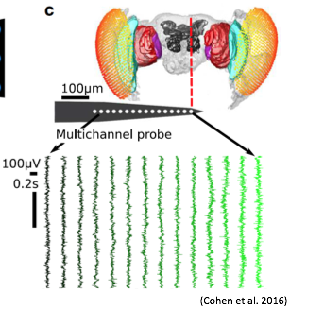
Structure of integrated information in flies
Drosophila melanogaster
Half-brain probe: 16 electrode sites
15 bipolar re-referenced channels
Choose 4 channels
2 conditions: awake and anaesthetised (0.6% isoflurane)

Slide 23
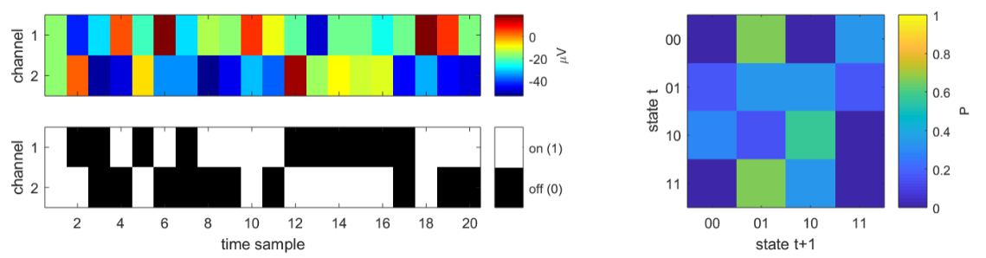
Information
time sample

Slide 24
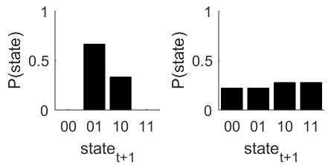
Information

Slide 25
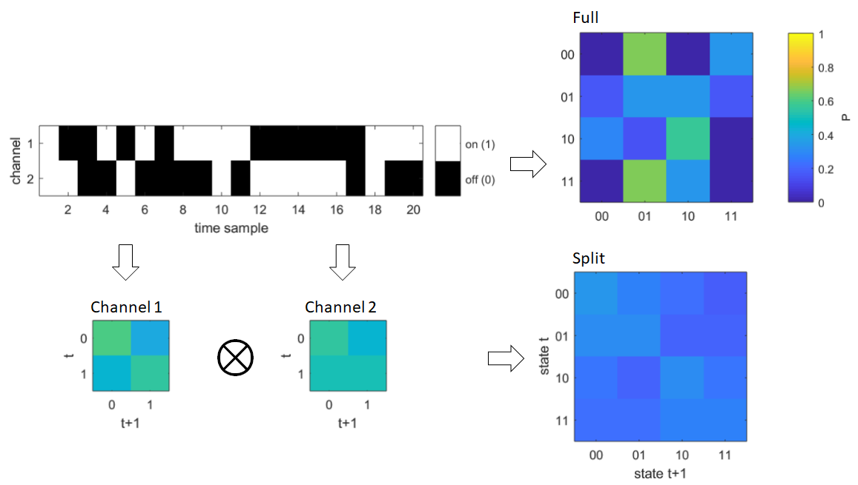
Integrated information

Slide 26
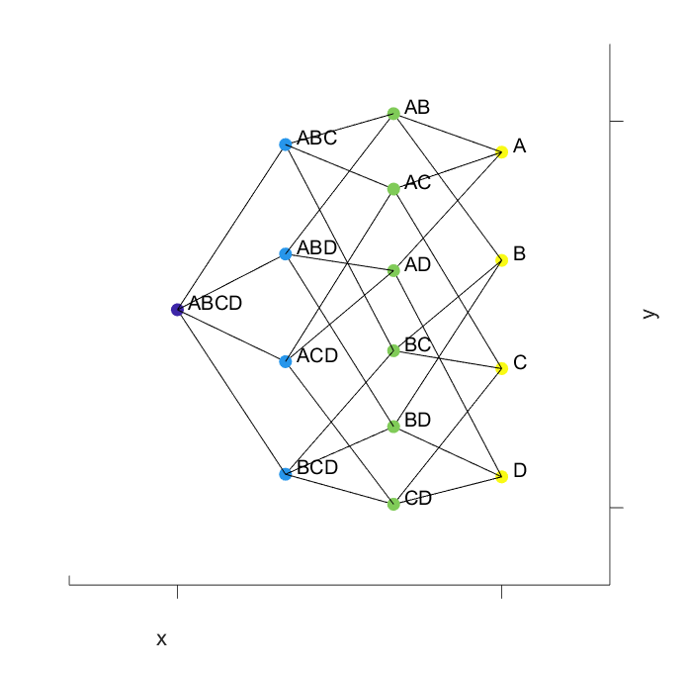
4 channel composition
Notes:
We find the integrated information of each mechanism
Top-down view

Slide 27
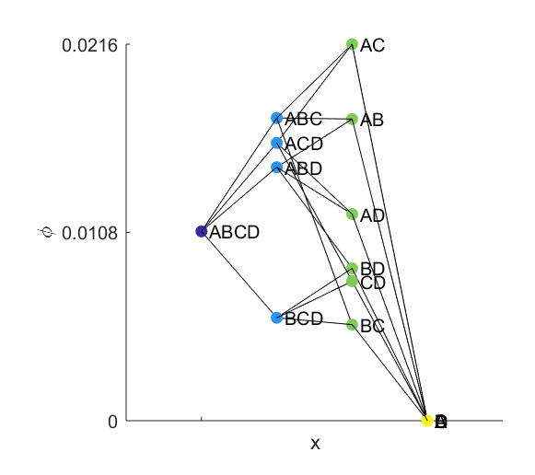
4 channel composition
Notes:
View from the side, y extends into the screen
ABCD is unique contribution (information) above and beyond ABC, ABD, etc.

Slide 28
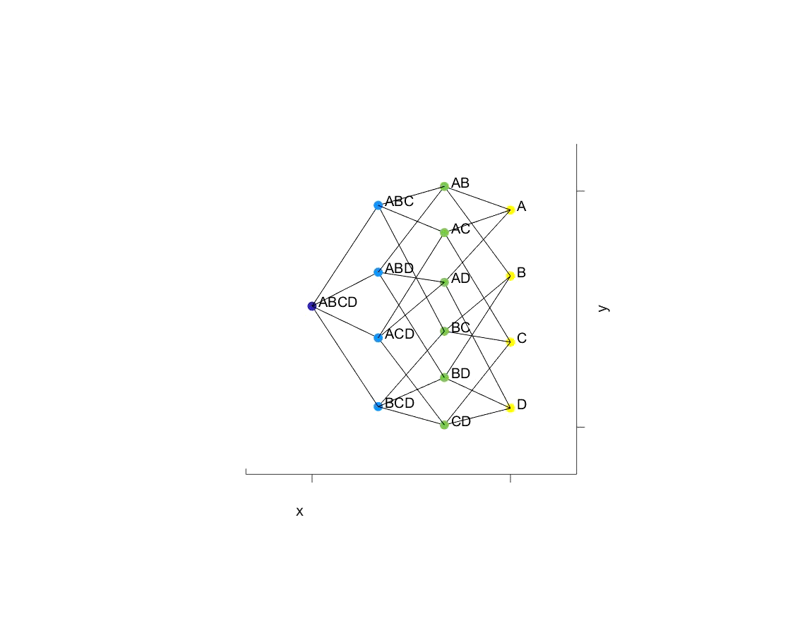
4 channel composition
Notes:
View from the side, y extends into the screen
ABCD is unique contribution (information) above and beyond ABC, ABD, etc.

Slide 29
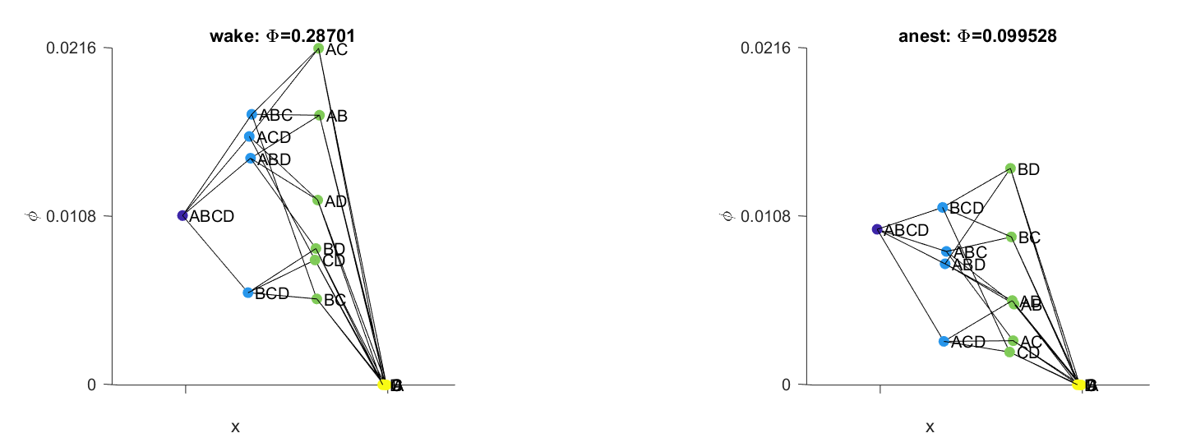
Awake vs anaesthetised
Notes:
Big Phi

Slide 30
Awake vs anaesthetised
Notes:
Big Phi

Slide 31
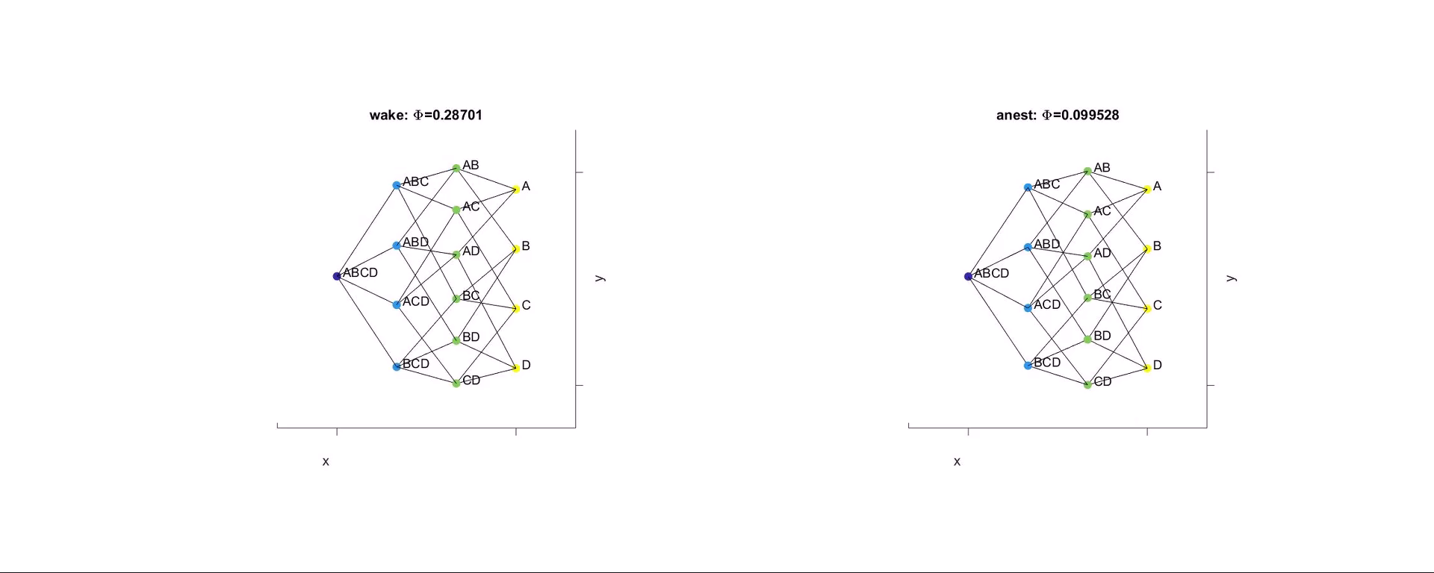
Awake vs anaesthetised
Notes:
Small phi of each is change in phi after cutting the system
Tau = 24 ms

Slide 32
Summary
IIT axioms
Existence
Composition
Information
Integration
Composition with greatest Φ at some spatiotemporal scale is the conscious experience of the system
Reduced Φ in the fly brain during anaesthesia

Slide 33
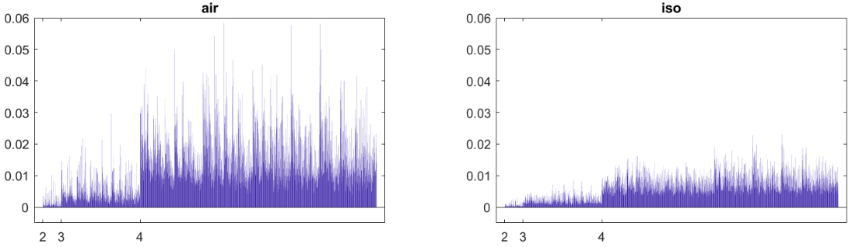
Φ values for 1 fly
Φ
n channels
Notes:
Introduce 2v3v4 channels
Tau = 4ms (step over 4 samples, not averaging over 4 samples)

Slide 34
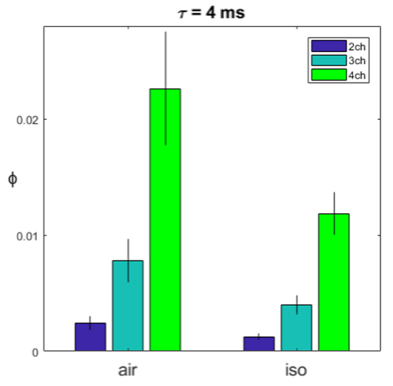
Φ values across N=13 flies
wake
anest.

Slide 35
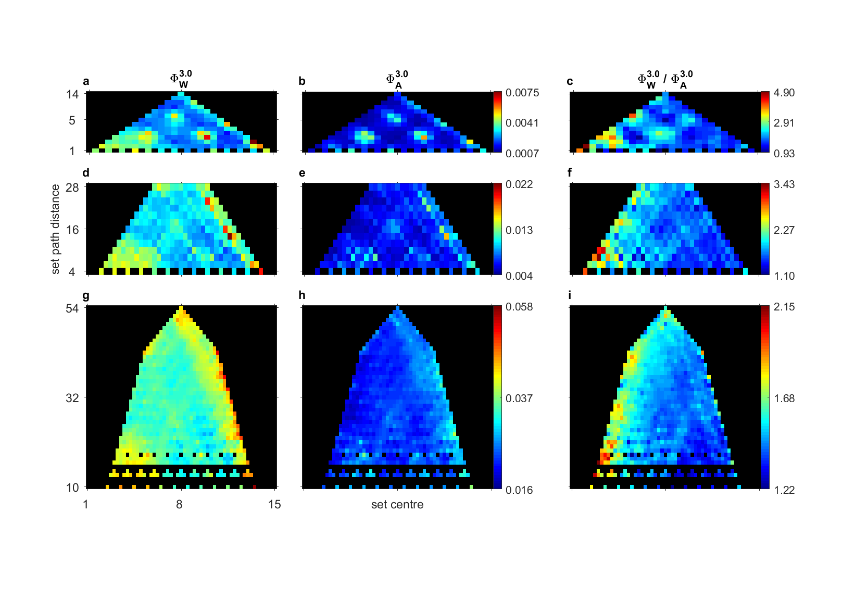
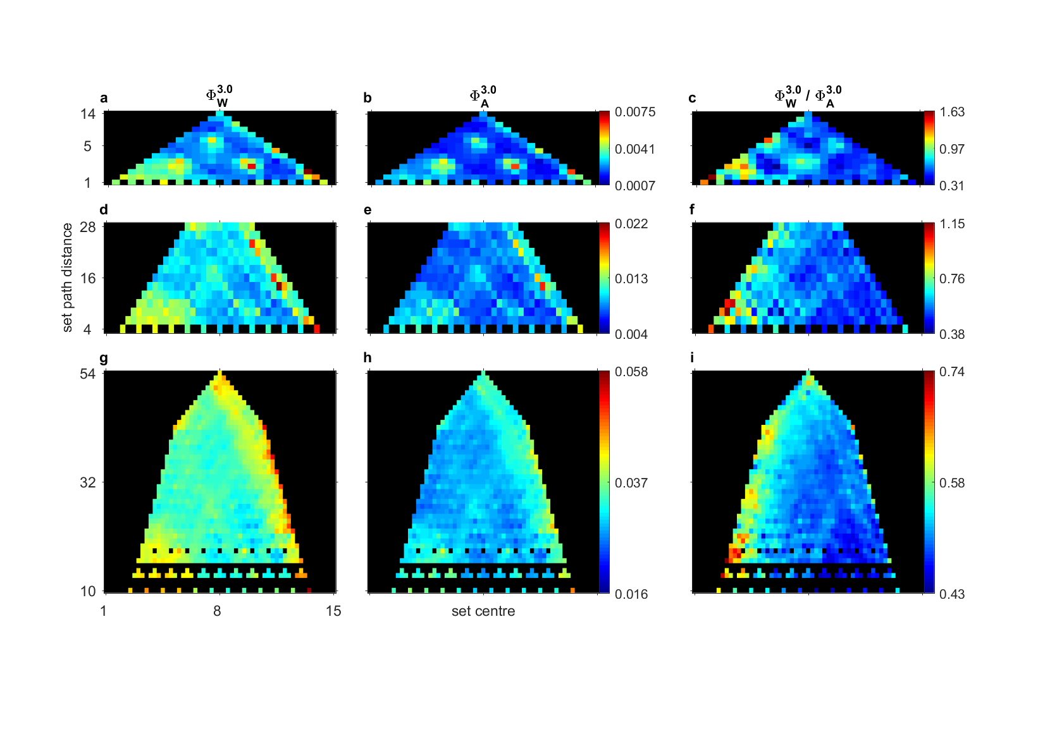
Φ values across N=13 flies
wake
Φ
anest.
wake / anest.

Slide 36
Exclusion
A
A
B
B
C
Notes:
Border of conscious substrate

Slide 37
Exclusion
A
A
B
B
C
Notes:
Temporal grain of consciousness

Slide 38
Exclusion
A
A
B
B
1 2 3 4 5 ….
C
Notes:
Temporal grain of consciousness

Slide 39
Exclusion
A
A
B
B
1 2 3 4 5 ….
C
Notes:
Temporal grain of consciousness

Slide 40
Exclusion
A
A
B
B
1 2 3 4 5 ….
C
Find where Φ is maximal
Notes:
Temporal grain of consciousness

Slide 41
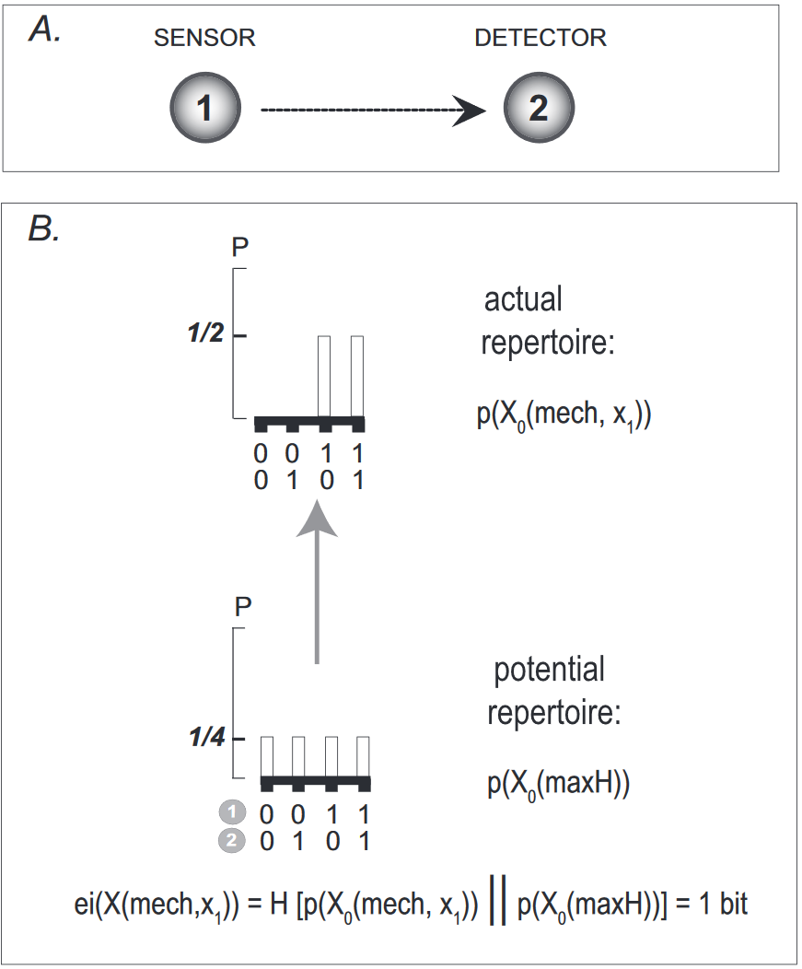
Composition
Φ
Full system
Split system

Slide 42
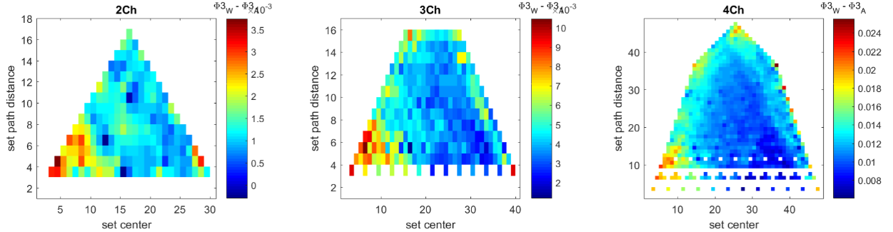

Slide 43
Summary
IIT axioms
Information - contribution of a part/mechanism to the system
Integration - is the the contribution reducible?
Existence - a part exists for the system if its contribution is irreducible
Composition - find contribution of every possible part
Exclusion - find contribution at each spatial and temporal scale
Composition with greatest Φ at some spatiotemporal scale is the conscious experience of the system

